Slide 1
Laparoscopic Surgery & Medical VR: How effective are they?
By: Kimberly Fernandez & Courtney Gaddy

Slide 2
What is laparoscopic surgery?
Laparoscopic surgery (minimally invasive surgery) is the performance of surgical procedures with the assistance of a video camera and several thin instruments.

Slide 3
Laparoscopic Procedure
Small incisions of up to half and inch are made and plastic tubes called ports are placed through these incisions. A camera and instruments are put into the ports and this allows access to the inside of a patient.
The video camera serves as the eyes of the surgeon.

Slide 4
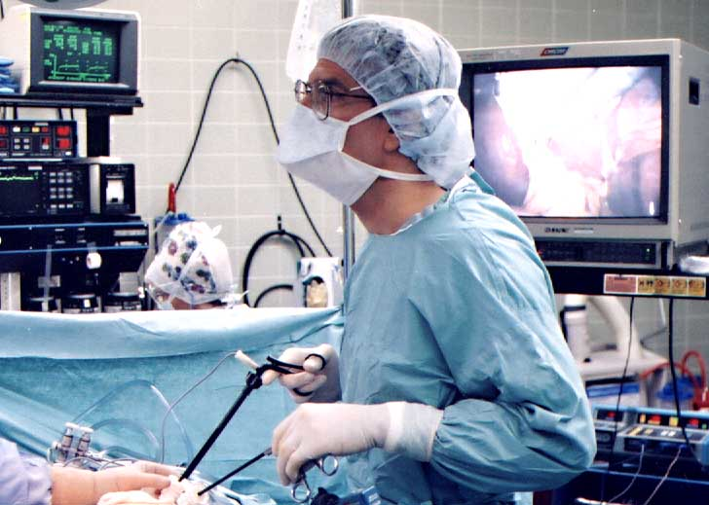
Laparoscopic Procedure

Slide 5
Benefits of Laparoscopic Surgery
Quick recovery times
Less post op discomfort
Smaller scars
Less internal scarring
Quicker return to full activites

Slide 6
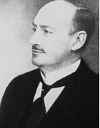
Origins
First laparoscopic procedure performed in 1902 by Georg Kelling of Dresden, Germany in a dog.
1910-First laparoscopic procedure performed in a human by Hans Christian Jacobaues of Sweden.
Hans Christian Jacobaeus

Slide 7
Origins
Invention of the computer chip television camera was a seminal event in the field of laparoscopy.
Provided means to project a magnified view onto monitor while freeing both hands of the operating surgeon.

Slide 8
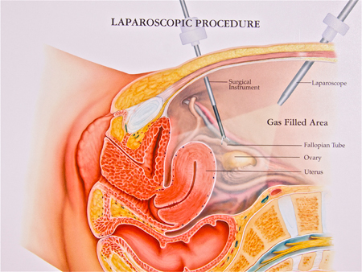
Origins
Prior to 1990 the only specialty that performed laparoscopic procedures was gynecology usually for short and simple procedures like diagnostic laparoscopies and tubal ligation.

Slide 9
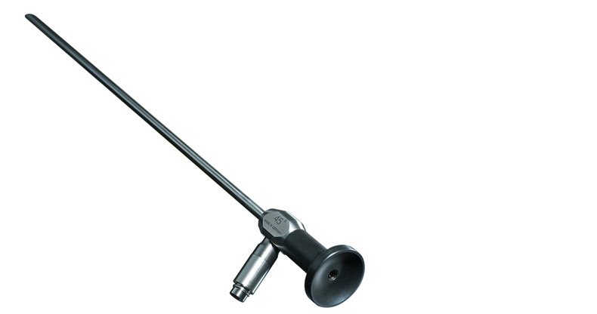
Laparoscopes
The key element in any laparoscopic procedure is a laparoscope. The two types of laparoscopes are a telescopic rod lens system, and a digital laparoscope.

Slide 10
Telescopic Rod Lens System
Usually connected to a video camera
Also attached is a fiber optic cable system connected to a light source to illuminate the operative field.

Slide 11
Digital Laparoscope
Charge coupled device is placed at end of the laparoscope, eliminating the rod lens.
Also attached is a fiber optic cable system connected to a light source to illuminate the operative field.

Slide 12
Carbon Dioxide Gas and Laparoscopy
Before the laparoscopic procedure is performed, the abdomen is insufflated or blown up like a balloon with carbon dioxide gas.
This causes elevation of the abdominal wall above the internal organs like a dome to create a working and viewing space.

Slide 13
Why is CO₂ Used?
Carbon dioxide is common in the human body
It can be absorbed by tissue and removed by the respiratory system.
It is non-flammable. This is important because electrosurgical devices are commonly used in laparoscopic procedures.

Slide 14
Laparoscopic Appendectomy
http://www.youtube.com/watch?v=M8RhIDOz-5U

Slide 15
da Vinci Surgery
With the da Vinci Surgical System, surgeons operate through just a few small incisions.
It features a 3D high definition vision system and tiny wristed instruments that bend and rotate far greater than the human wrist.
Surgeon is 100% in control of the da Vinci system which translates his or her hand movements into smaller, more precise movements of tiny instruments inside the body.

Slide 16
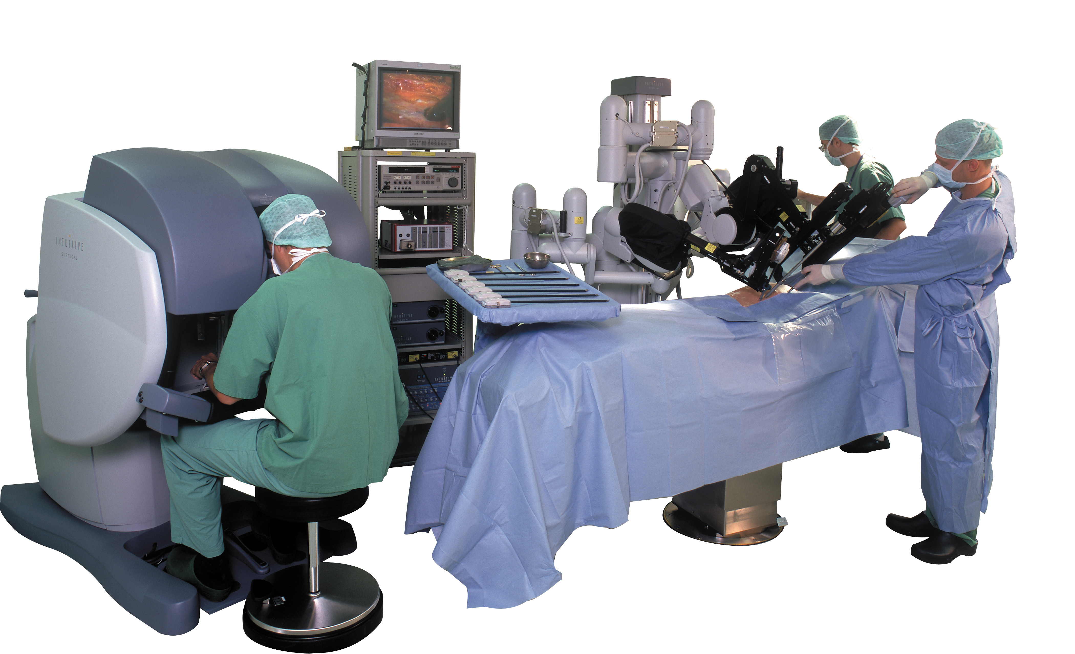
da Vinci Surgery
http://www.davincisurgery.com

Slide 17
Medical VR
A system of computer generated three dimensional imaginary environments with which a person can subjectively interact.
Ex: Medical research to monitor brain activity in the hippocampus of subjects trying to solve maze problems.

Slide 18
Medical Virtual Reality Overview
http://www.youtube.com/watch?v=jZbO2tPvCc4&list=PLD256E96553F1BBE3

Slide 19
Examples of VR in the medical field
Physicians and trainees can use VR to plan and conduct remote surgeries or assist others with surgeries.
3-D models of the human body can be created, giving medical students or practitioners views of the human body and how it interacts.
VR can be used in rehabilitation and therapy by distracting patients who might otherwise experience pain.
3D imaging created by diagnostic tools to allow physicians to have a total view of a patient.

Slide 20
Virtual Reality Exposure Therapy
Treats panic and anxiety disorders
Phobias such as fears of flying, driving, heights, posttraumatic stress disorder, etc.
Places client in a computer-generated world where they “experience” various stimuli related to their phobia.
A head-mounted display with small TV monitors and stereo earphones are worn so the client can receive both visual and auditory cues

Slide 21
Physical and Cognitive Rehabilitation
VR game-based technology used to improve motor skill.
Design approach focuses on creation of flexible VR systems/tool the could address both assessment and training tasks

Slide 22
Virtual Human
Provide believable and natural interactions
Enable applications such as virtual guide for medical information outreach, simulated standardized patients for training, personalized coached for rehabilitation and wellness

Slide 23
VR as a Medical Training Tool
Aim: to offer additional means to teach students
Goals: To halve the “on the fly” learning in the operating room with real patients. To improve quality of medical treatment. To improve and test operating skills.

Slide 24
VR as a Medical Training Tool
Within a virtual operating room students practice technical skills, the procedures, and the theoretical background of operations and diseases
Haptic devices, 3D vision, and a 3D model system are used for such training

Slide 25
VR training first line professionals
Aims: to learn decision making skills as well as the practical hands on skills required in the type of situation.
Goal: to teach these professionals how to respond when time is of essence and how to response without the risk of harm to themselves or their patients.

Slide 26
VR training front line professionals
Used to train first responders to deal with small and large-scale emergencies.
Virtual environments are developed to represent different scenarios, for example, road traffic accident
Training system can be used over and over with the option to adjust according to skill level and experience

Slide 27
Benefits of Virtual Reality
Safety
Time
Money
Ability to re-use on a regular basis/refresh skills
Can be used remotely
Efficiency
Realistic

Slide 28
Challenges of Virtual Reality
Limited range of motion
Poor depth perception
Inability to accurately judge how much force is being applied to tissue
Reduces tactile sensation
Doesn’t have the same consequences as training in the real world

Slide 29
VR still growing
Why hasn’t virtual reality taken off?
Price
Vertigo/Eye Strain- people have issues focusing on the screens in VR headsets
Lack of interest

Slide 30
Laparoscopic Surgery without Virtual Reality Training
Training for Laparoscopic surgery is time consuming and costly without the use of VR because surgical trainees must practice under the supervision of a trained surgeon.
Different methods of this surgical training include the use of live animals and human and animal cadavers.

Slide 31
Laparoscopic Surgery with Virtual Reality
Training using a Virtual Reality simulator is an option to supplement standard training.
VR improves technical skills of surgical trainees such as decreased time and improved accuracy.
Surgical trainees who practice using VR simulators go into their first surgeries with the experience of having performed 30-50 surgeries.

Slide 32
LapSim Laparoscopic Trainer
The LapSim virtual reality system is a combination of computer hardware and software modules which recreate the procedures and environment of abdominal keyhole surgery.
Uses advanced 3D technology to provide the trainee with a realistic virtual working environment. Practice sessions can vary in graphic complexity as well as in the level of difficulty.
Can be used for various types of laparoscopic procedures(appendectomy, hysterectomy, nephrectomy)

Slide 33
LapSim

Slide 34
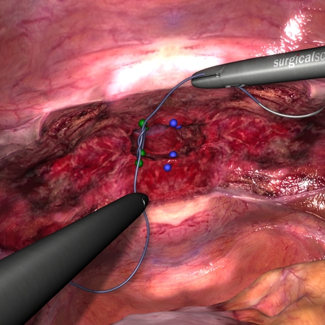
LapSim Images
http://www.bmj.com/multimedia/video/2009/01/21/effect-virtual-reality-training-laparoscopic-surgery

Slide 35
Are you ready to become a surgeon?
http://www.edheads.org/activities/brain_stimulation/index.shtml

